Slide 1

Equivalence Relations
Introduction to Relation
Lecturer-6
Dr. Prasant Kumar Nayak

Slide 2
Equivalence Relations
Equivalence Classes
Equivalence Classes and Partitions
Equivalence Relations
Definition 1: A relation on a set A is called an equivalence relation if it is reflexive, symmetric, and transitive.
Definition 2: Two elements a, and b that are related by an equivalence relation are called equivalent. The notation a ∼ b is often used to denote that a and b are equivalent elements with respect to a particular equivalence relation.

Slide 4
Example: Let m be an integer with m > 1. Show that the relation
R = {(a,b) | a ≡ b (mod m)}
is an equivalence relation on the set of integers.

Slide 7
Equivalence Relations
Conti….
Example: Let m be an integer with m > 1. Show that the relation
R = {(a,b) | a ≡ b (mod m)}
is an equivalence relation on the set of integers.
Solution: Recall that a ≡ b (mod m) if and only if m divides a − b.
Reflexivity: a ≡ a (mod m) since a − a = 0 is divisible by m since 0 = 0 ∙ m.
Symmetry: Suppose that a ≡ b (mod m). Then a − b is divisible by m, and so a − b = km, where k is an integer. It follows that b − a = (− k) m, so b ≡ a (mod m).

Slide 8
Equivalence Relations
Conti….
Transitivity: Suppose that a ≡ b (mod m) and b ≡ c (mod m).
Then m divides both a − b and b − c. Hence,
there are integers k and l with
a − b = km and b − c = lm.
We obtain by adding the equations:
a − c = (a − b) + (b − c) = km + lm = (k + l) m.
Therefore, a ≡ c (mod m).

Slide 9
Equivalence Relations
Conti….
Example: Show that the “divides” relation on the set of positive integers is not an equivalence relation.
Solution: The properties of reflexivity, and transitivity do hold, but there relation is not symmetric. Hence, “divides” is not an equivalence relation.
Reflexivity: a ∣ a for all a.

Slide 10
Example: Show that the “divides” relation on the set of positive integers is not an equivalence relation.

Slide 12
Equivalence Relations
Conti….
Not Symmetric: For example, 2 ∣ 4, but 4 ∤ 2. Hence, the relation is not symmetric.
Transitivity: Suppose that a divides b and b divides c. Then there are positive integers k and l such that b = ak and c = bl. Hence, c = a(kl), so a divides c. Therefore, the relation is transitive.

Slide 13
Partial Orderings and Partially-ordered Sets
Lexicographic Orderings
Hasse Diagrams
Partial Orderings.
Definition 1: A relation R on a set S is called a partial ordering, or partial order, if it is reflexive, antisymmetric, and transitive.
A set together with a partial ordering R is called a partially ordered set, or poset, and is denoted by (S, R). Members of S are called elements of the poset.

Slide 14
Partial Orderings and Partially-ordered Sets
Lexicographic Orderings
Hasse Diagrams
Partial Orderings.
Example 1: Show that the “greater than or equal” relation (≥) is a partial ordering on the set of integers.
Reflexivity: a ≥ a for every integer a.
Anti symmetry: If a ≥ b and b ≥ a , then a = b.
Transitivity: If a ≥ b and b ≥ c , then a ≥ c.

Slide 16
Partial Orderings and Partially-ordered Sets
Lexicographic Orderings
Hasse Diagrams
Partial Orderings.
Example 2: Show that the divisibility relation (∣) is a partial ordering on the set of integers.
Reflexivity: a ∣ a for all integers a.
Anti symmetry: If a and b are positive integers with a | b and b | a, then a = b.

Slide 17
Partial Orderings and Partially-ordered Sets
Lexicographic Orderings
Hasse Diagrams
Partial Orderings.
Transitivity: Suppose that a divides b and b divides c. Then there are positive integers k and l such that b = ak and c = bl. Hence, c = a(kl), so a divides c. Therefore, the relation is transitive.
(Z⁺, ∣) is a poset.

Slide 18
Partial Orderings and Partially-ordered Sets
Lexicographic Orderings
Hasse Diagrams
Partial Orderings.
Example 3: Show that the inclusion relation (⊆) is a partial ordering on the power set of a set S.
Reflexivity: A ⊆ A whenever A is a subset of S.
Anti symmetry: If A and B are positive integers with A ⊆ B and B ⊆ A, then A = B.
Transitivity: If A ⊆ B and B ⊆ C, then A ⊆ C.

Slide 20
Partial Orderings and Partially-ordered Sets
Lexicographic Orderings
Hasse Diagrams
Partial Orderings.
Example 3: Show that the inclusion relation (⊆) is a partial ordering on the power set of a set S.
Reflexivity: A ⊆ A whenever A is a subset of S.
Anti symmetry: If A and B are positive integers with A ⊆ B and B ⊆ A, then A = B.
Transitivity: If A ⊆ B and B ⊆ C, then A ⊆ C.

Slide 21
Comparability
Definition 2: The elements a and b of a poset (S,≼ ) are comparable if either a ≼ b or b ≼ a. When a and b are elements of S so that neither a ≼ b nor b ≼ a, then a and b are called incomparable.
The symbol ≼ is used to denote the relation in any poset.

Slide 23
Comparability
Definition 3: If (S,≼ ) is a poset and every two elements of S are comparable, S is called a totally ordered or linearly ordered set, and ≼ is called a total order or a linear order. A totally ordered set is also called a chain.
Definition 4: (S,≼ ) is a well-ordered set if it is a poset such that ≼ is a total ordering and every nonempty subset of S has a least element.

Slide 25
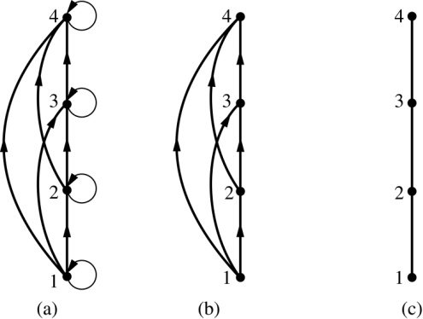
Hasse Diagrams
Definition: A Hasse diagram is a visual representation of a partial ordering that leaves out edges that must be present because of the reflexive and transitive properties.

Slide 26
Hasse Diagrams
A partial ordering is shown in (a) of the figure above. The loops due to the reflexive property are deleted in (b). The edges that must be present due to the transitive property are deleted in (c). The Hasse diagram for the partial ordering (a), is depicted in (c).

Slide 27
Procedure for Constructing a Hasse Diagram
To represent a finite poset (S,≼ ) using a Hasse diagram, start with the directed graph of the relation:
Remove the loops (a, a) present at every vertex due to the reflexive property.
Remove all edges (x, y) for which there is an element z ∈ S such that x ≺ z and z ≺ y. These are the edges that must be present due to the transitive property.
Arrange each edge so that its initial vertex is below the terminal vertex. Remove all the arrows, because all edges point upwards toward their terminal vertex.

Slide 28
Procedure for Constructing a Hasse Diagram
Example: Hasse diagram of poset ( {1, 2, 3, 4}, ≤)
4
3
2
1

Slide 29
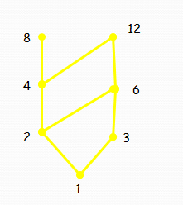
Procedure for Constructing a Hasse Diagram
Draw the Hasse diagram representing
the partial ordering { (a, b) | a divides b }
on {1, 2, 3, 4, 6, 8, 12}

Slide 30
Draw the Hasse diagram representing
the partial ordering { (a, b) | a divides b }
on {1, 2, 3, 4, 6, 8, 12}

Slide 31
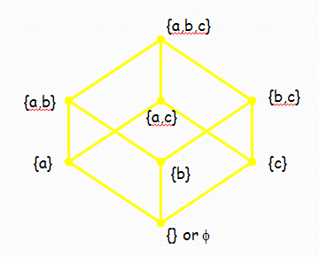
Procedure for Constructing a Hasse Diagram
Draw the Hasse diagram for the partial ordering
{ (A,B) | A ⊆ B } on the power set P(S)
where S = {a, b, c}

Slide 32
Draw the Hasse diagram for the partial ordering
{ (A,B) | A ⊆ B } on the power set P(S)
where S = {a, b, c}

Slide 33
Minimal and Maximal Elements
Let S be a partially ordered set.
An element a in S is called minimal if no other element of S strictly precedes a.
An element b in S is called maximal if no element of S strictly succeeds b.
They are respectively bottom and top elements in the diagram.
A Poset can have more than one minimal and more than one maximal elements.

Slide 34
Minimal and Maximal Elements
Which elements of the poset
({2, 4, 5, 10, 12, 20, 25}, | ) are maximal, and which are minimal.

Slide 35
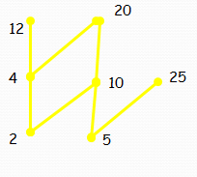
Minimal and Maximal Elements
The maximal elements are 12, 20 and 25, and the minimal elements are 2 and 5.

Slide 36
Minimal and Maximal Elements
An element a in a poset S is called least (or first) element if a precedes every other element of S.
An element b in poset S is called the greatest (or last) element if b succeeds every other element of S.

Slide 37
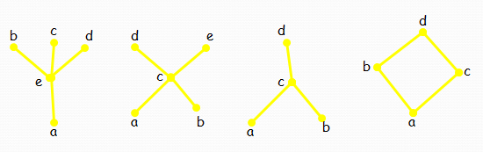
Minimal and Maximal Elements
Find greatest and least elements in Hasse diagrams

Slide 39
Least element is a no greatest element
No least element and no greatest element
No least element and d greatest element
Least element is a and greatest element d
Note : Greatest and least element s are unique when it is exist

Slide 40
Upper and Lower Bound
Let A be a subset of partially ordered set S.
An element u in S is called an upper bound of A if u succeeds every element of A and u relate every element of A.
An element l in a poset S is called a lower bound of A if l precedes every element of A and l relate every element of A.
.

Slide 41
Upper and Lower Bound
What is the upper and lower bound of set {3,4}.
From following poset
5
6
4
3
1
2

Slide 42
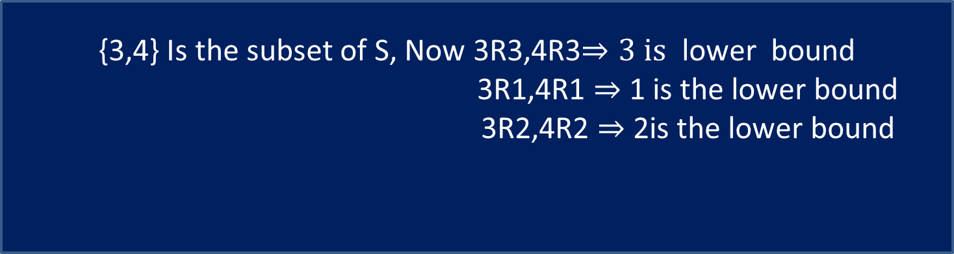
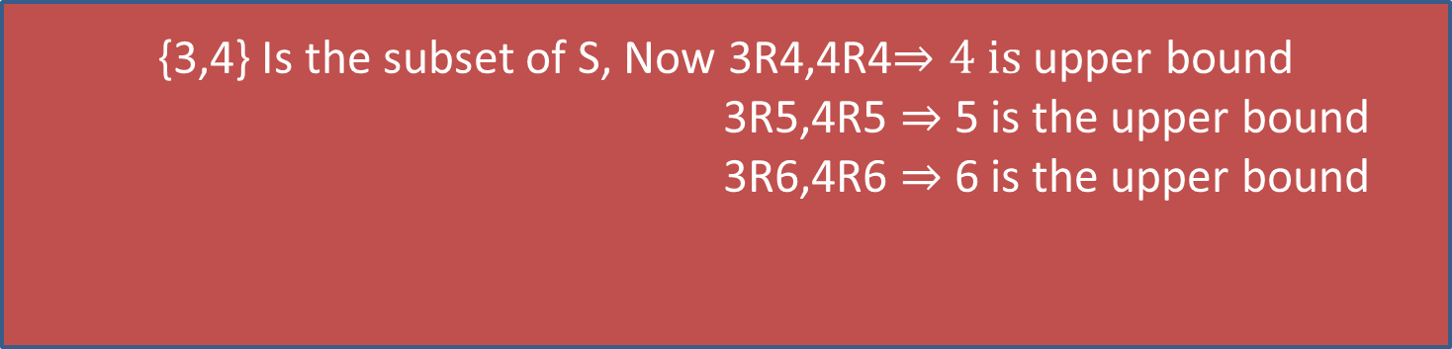
Upper and Lower Bound
{3,4} Is the subset of S, Now 3R4,4R4$⇒4 is$upper bound
3R5,4R5 $⇒$ 5 is the upper bound
3R6,4R6 $⇒$ 6 is the upper bound
{3,4} Is the subset of S, Now 3R3,4R3$⇒3 is$ lower bound
3R1,4R1 $⇒$ 1 is the lower bound
3R2,4R2 $⇒$ 2is the lower bound

Slide 43
Upper and Lower Bound
What is the upper and lower bound of set {1,3} and {4,5}.
From following poset of
1
2
3
4
5

Slide 44
Upper and Lower Bound
Lower bound of {1,3} ={3,4,5}
Lower bound of {4,5} ={5}
Upper bound {1,3} is {1}
Upper bound {4,5} is {1,2,3,4}

Slide 45
Upper and Lower Bound
Supremum
If an upper bound of A precedes every other upper bound of A, then it is called the supremum or least upper bound of A and is denoted by sup(A) or lub(A).
Infimum
If a lower bound of A succeeds every other lower bound of A, then it is called the infimum or greatest lower bound of A and is denoted by inf(A) or glb(A).

Slide 46
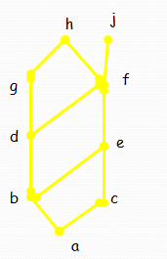
Minimal and Maximal Elements
Find the lower and upper bounds of the subsets {a, b, c}, {j, h} and {a, c, d, f} in the poset with the given Hasse diagram.

